Slide 1

THE CZECH CYSTIC FIBROSIS ASSOCIATION

Slide 2
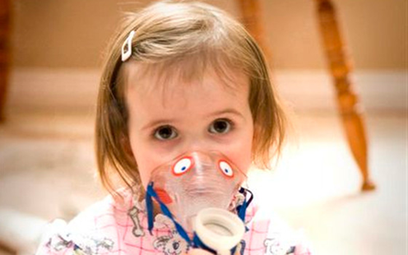

THE CZECH CYSTIC FIBROSIS ASSOCIATION
it was founded in 1992
it is the only nonprofit organization that unites and helps patients in the Czech Republic
we have 436 members
our mission:
improving the quality of life of patients and to prolong life expectancy
provides psychological and social counselling
contributes to inhalators, medical equipment and reconditioning stays
publishes educational materials for patients with cystic fibrosis
informs the public about the disease.

Slide 3


THE ASSOCIATION´S MISSION
providing CF patients and their families with psychosocial support through a range of social services
supporting mutual cooperation of CF patients and teams of CF Centers in the Czech Republic
medialisation of CF
supporting projects aimed at improving CF treatment.
pacients advocacy – lobbying for early access to orphan
drugs for CF

Slide 4
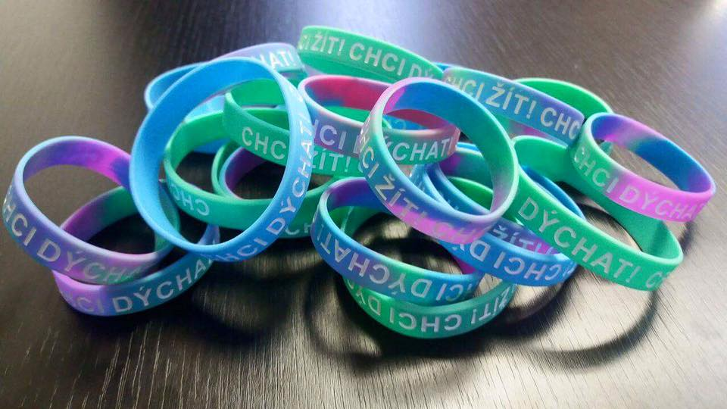
SOCIAL SERVICES
CF Association provides:
basic and professional social counselling
crisis intervention, emotional support
networking = search and transfer contacts with relevant organizations
defending legitimate interests of clients in the social and health care systems, health insurance, in the school system, etc.
CF Associationʼs activities:
support for educational stay at University Hospital Motol
self-supporting stays for parents of sick children

Slide 5
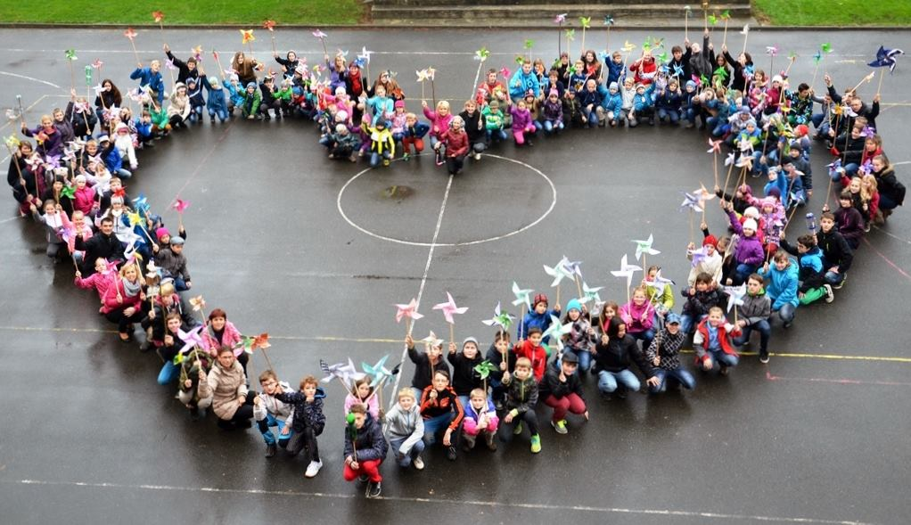
ACTIVITIES
The CF Association carries out many events
the goal is to inform public about this disease
to achieve financial resources to help CF patients.
Theather plays for our donors and supporters
Forest theater festivals
European day for cystic fibrosis -
„Pinwheel day“
Salty Women calendar by Robert Vano
Auction of photos from the calendar
Christmas charity concert

Slide 6
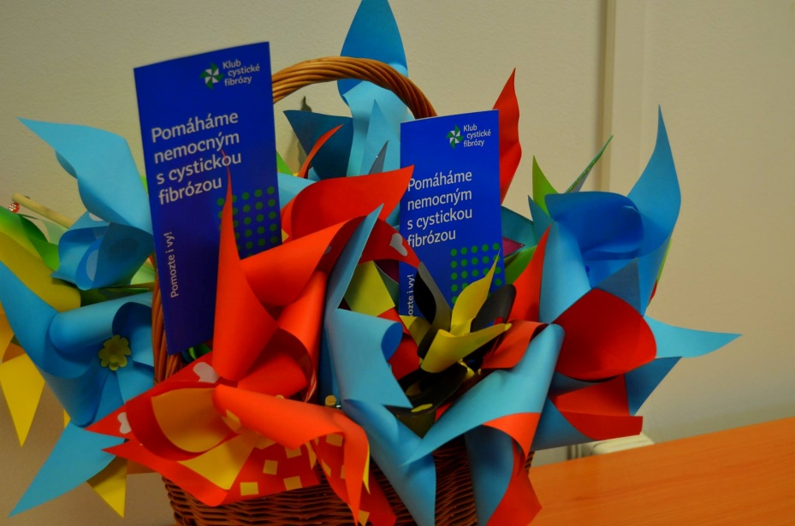
PINWHEEL DAY
European Day for cystic fibrosis is on November 21
individuals, families, groups, associations, organizations, companies, teams and just anyone who wants to support the salty children simply makes a pinwheel that day and sends their picture to our Association
pictures are posted on our FB, everybody can vote which one is „the best one“. The winner gets a gift from the Association
The main objective of Pinwheel Day is to raise awareness amongst the general public – ideally to combine with fundraising
regularly held in many cities (about 100 schools)
goal: increase awareness, fundraising (new donors)

Slide 7
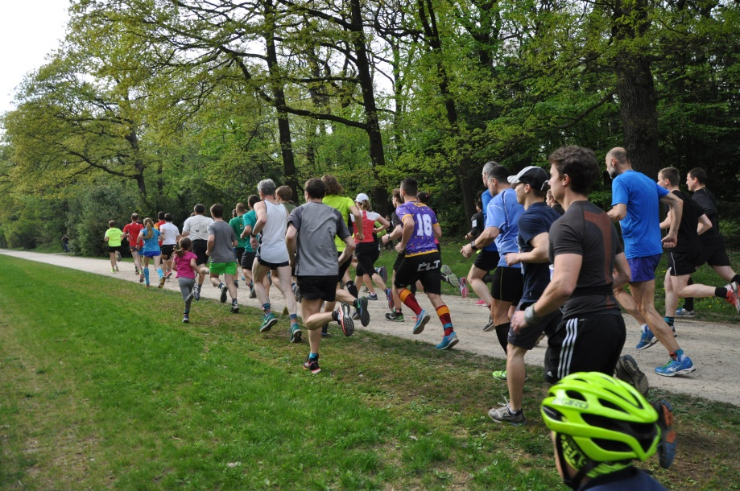
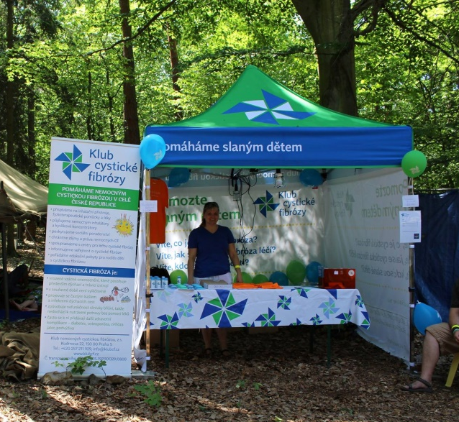
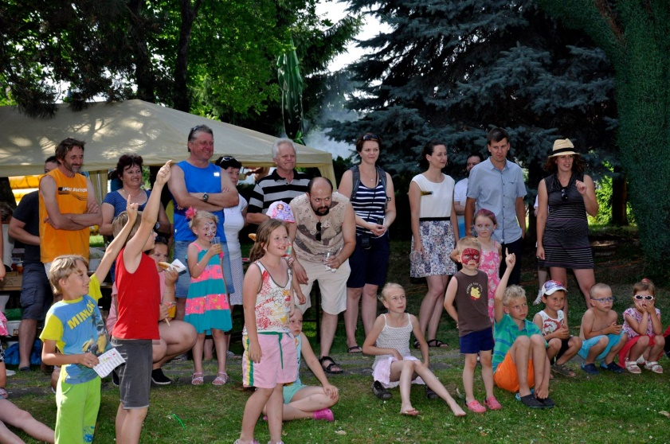
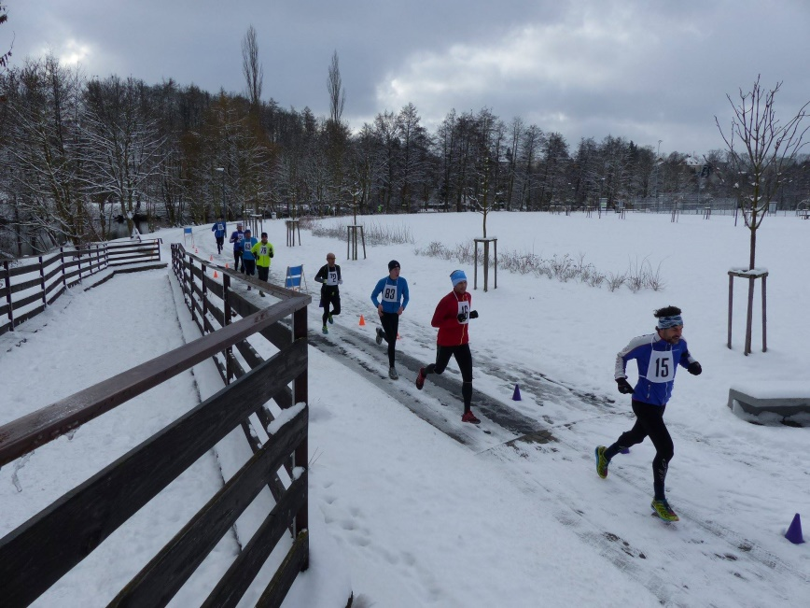
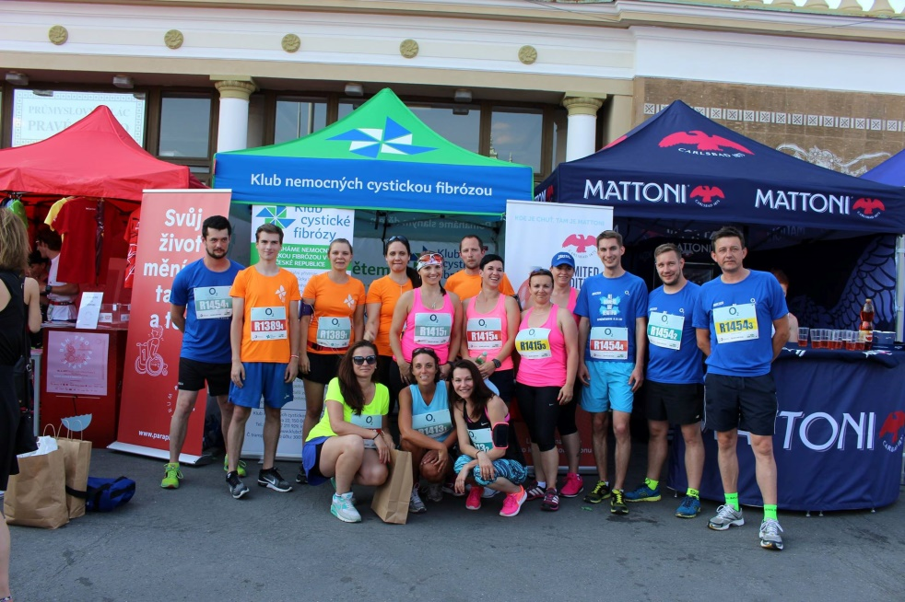
Activities of our patients and their families

Slide 8
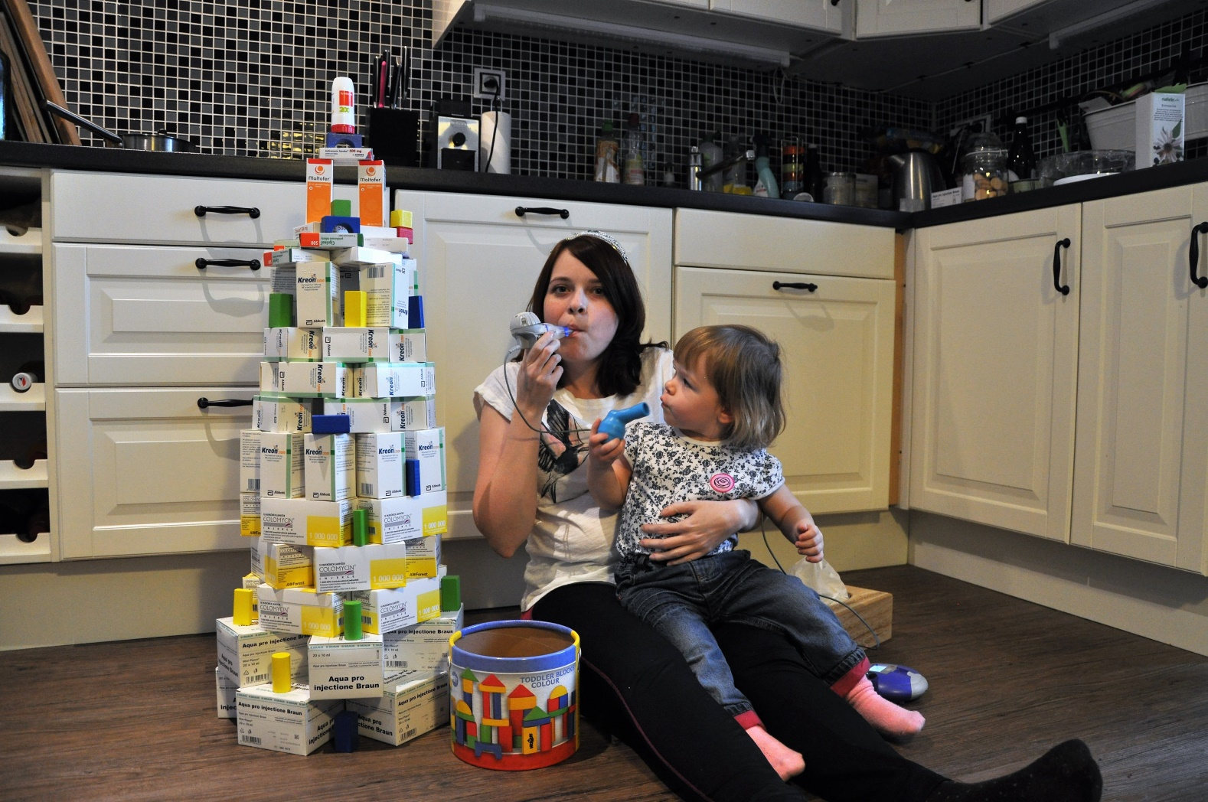
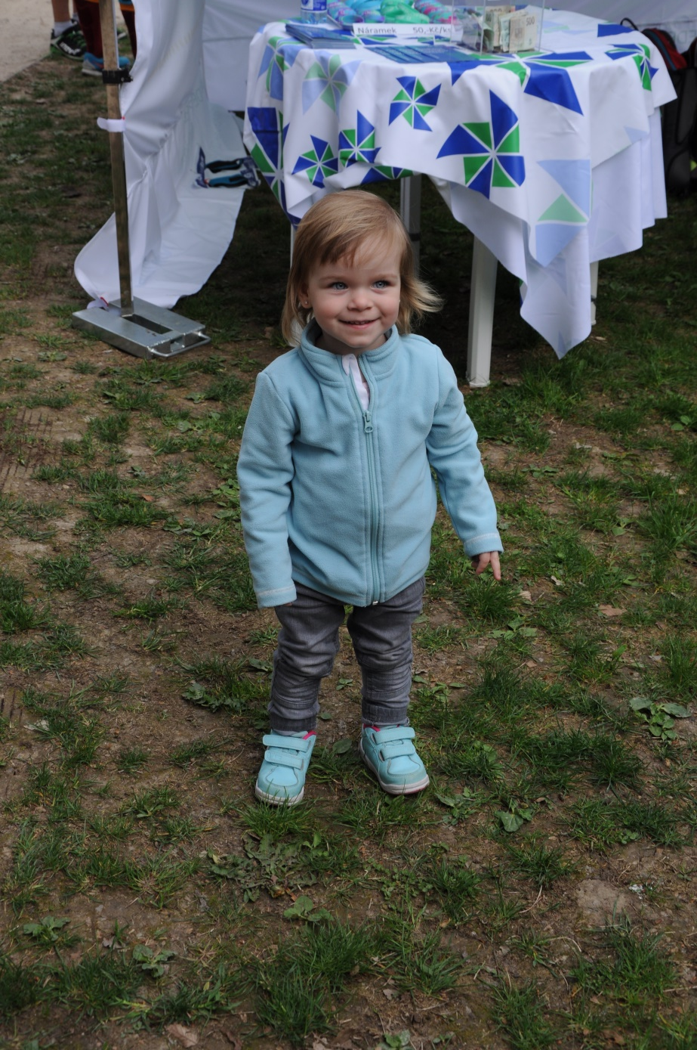
My and my daughter

Slide 9
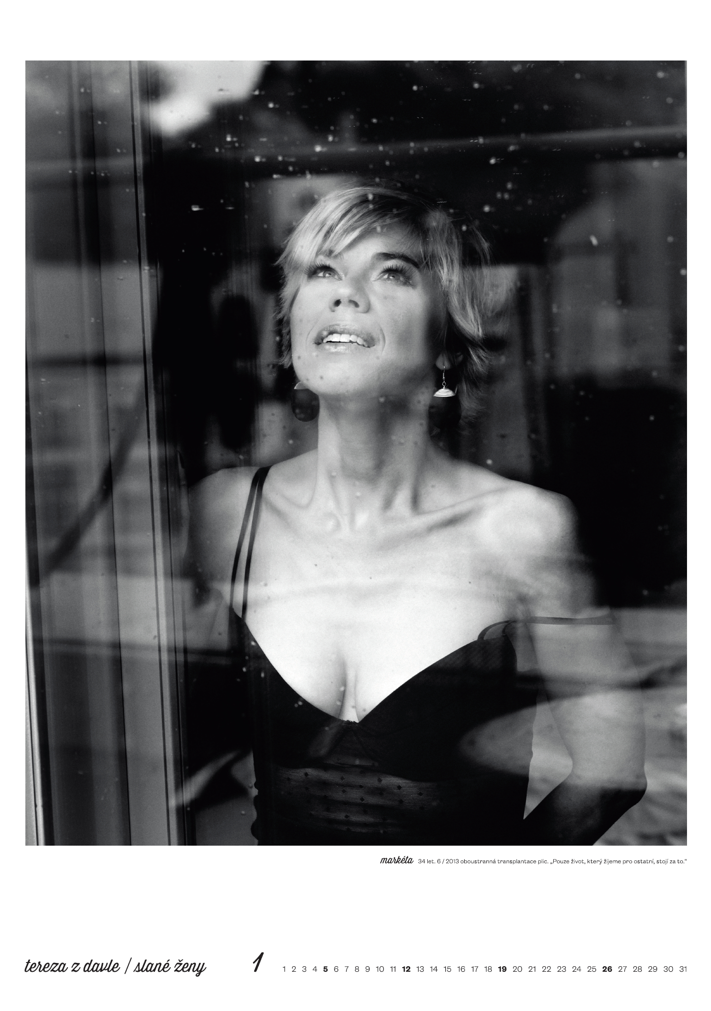
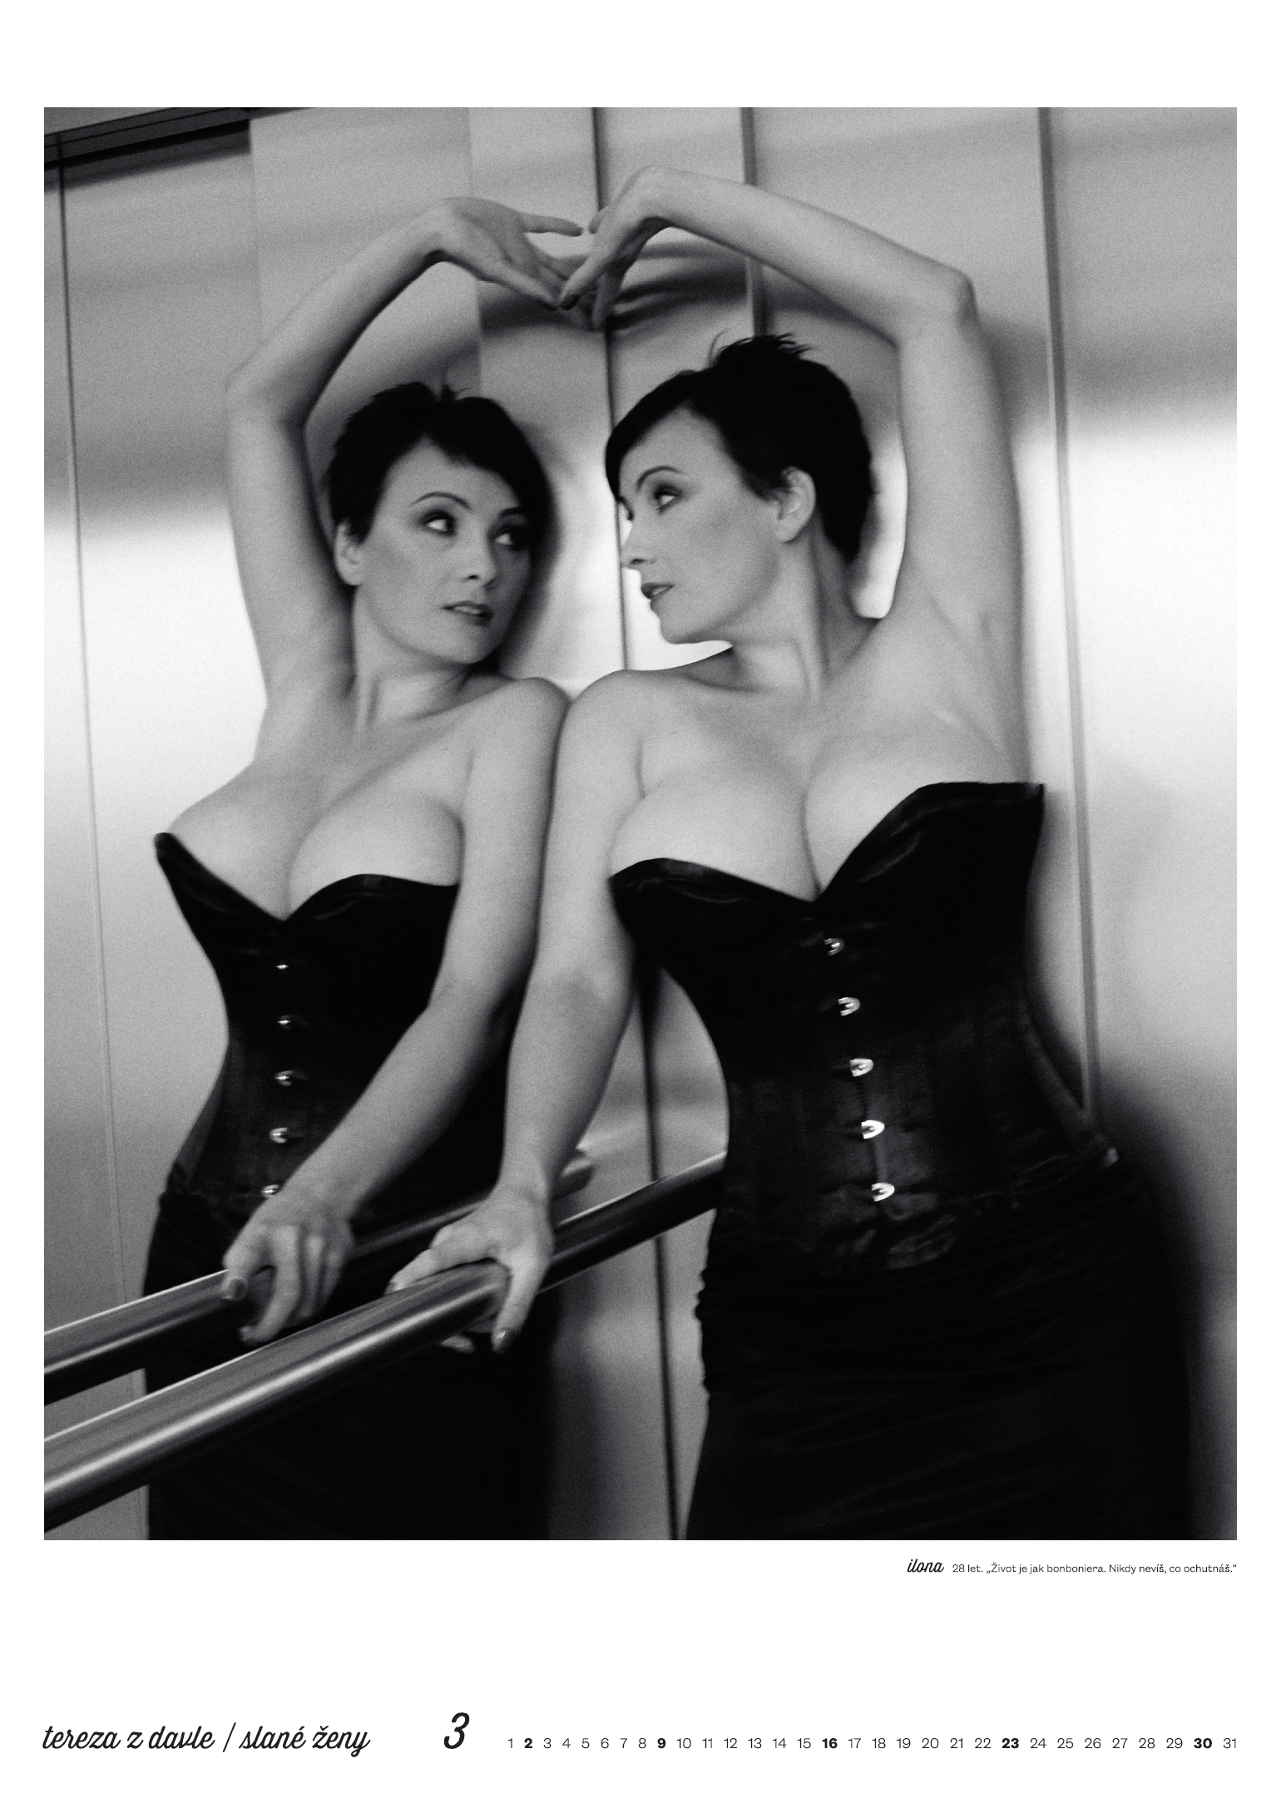
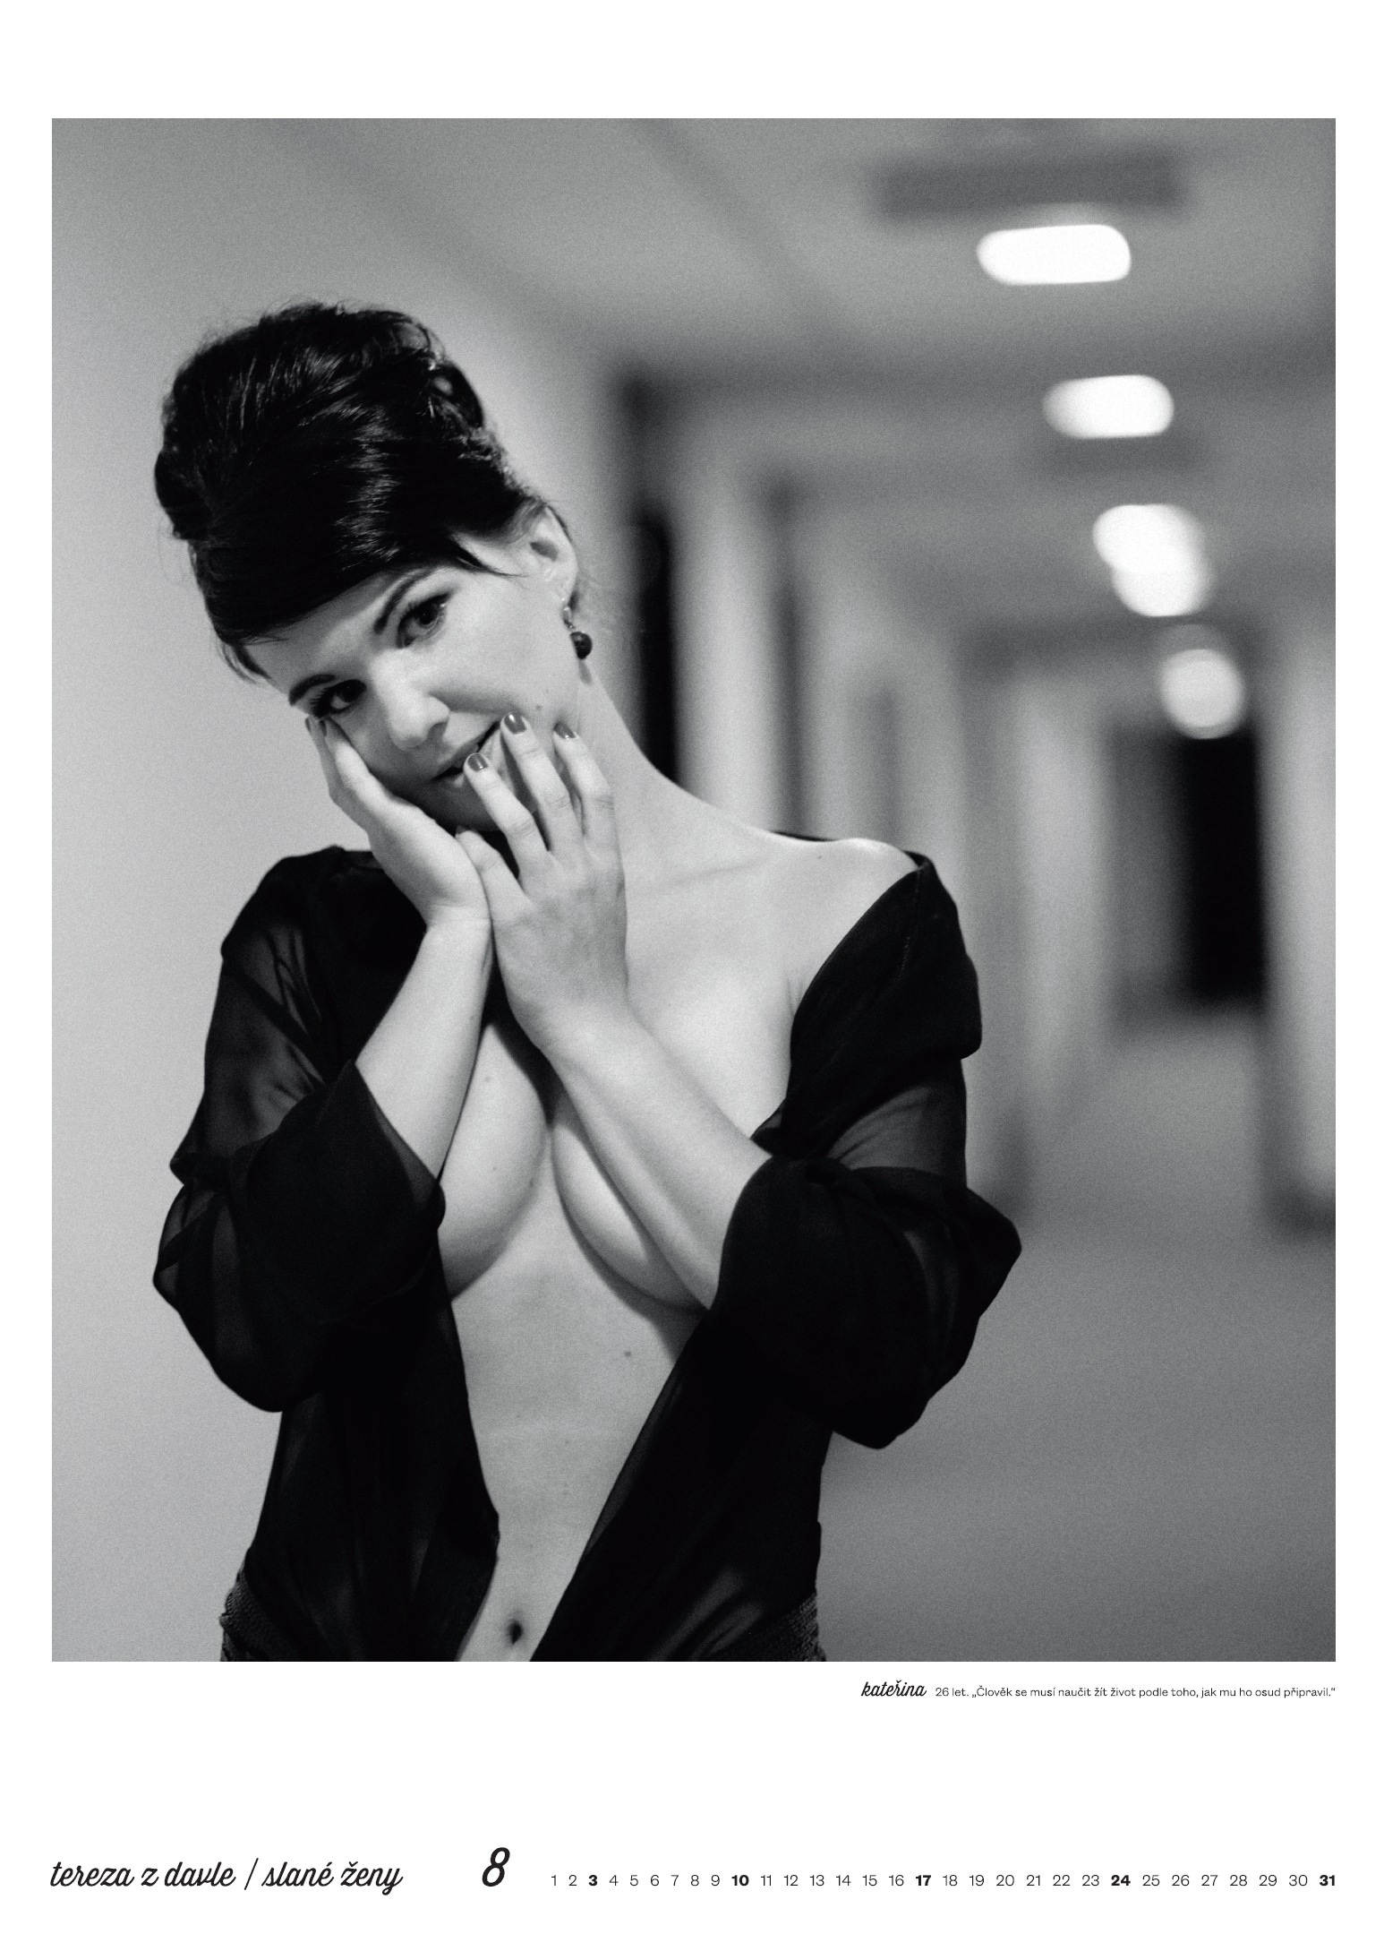
SALTY WOMEN CALENDAR 2014

Slide 10

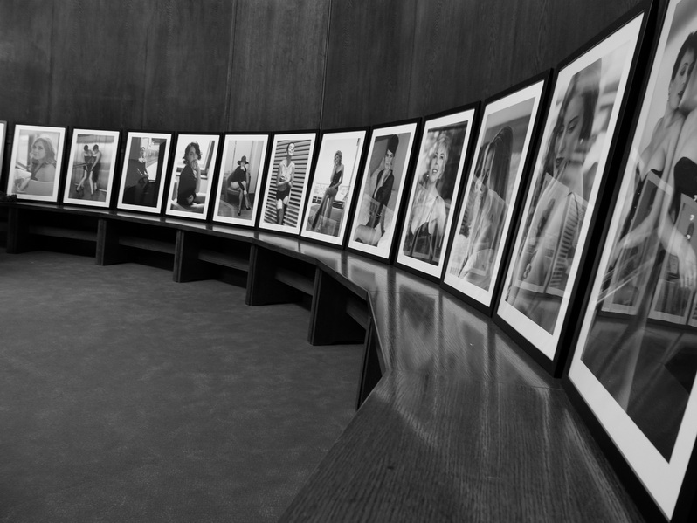
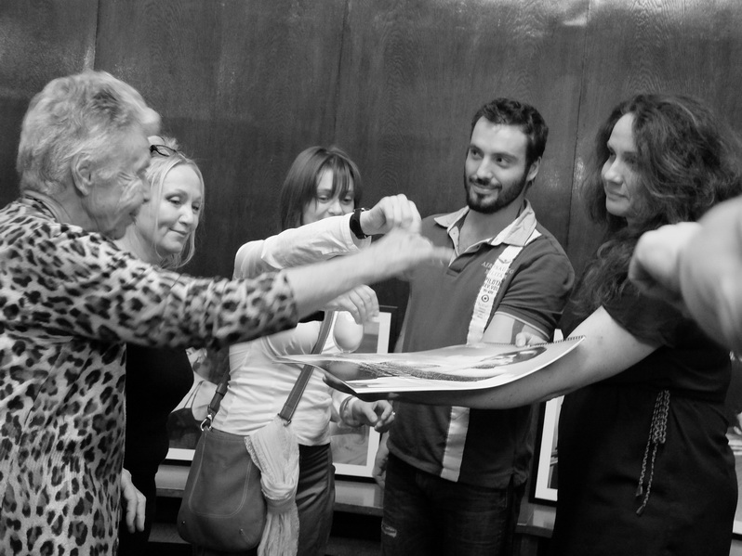

Slide 11
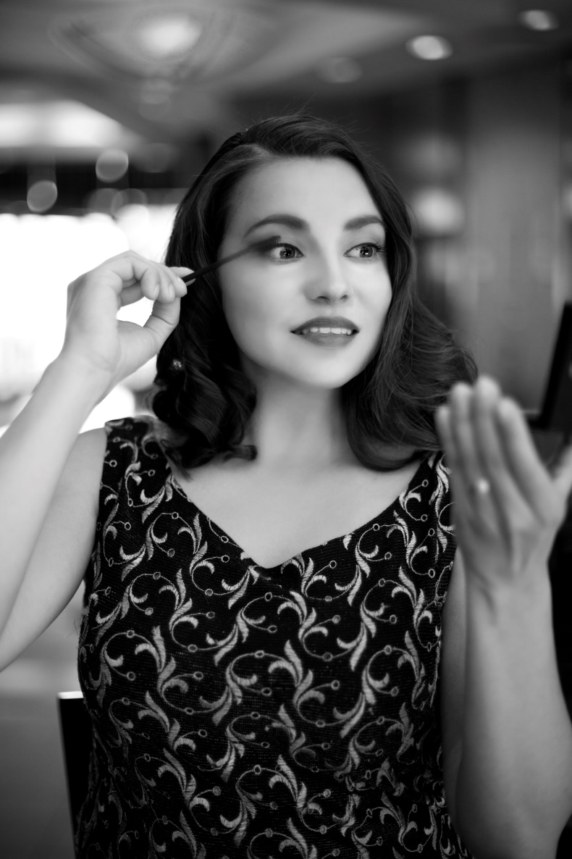
SALTY WOMEN CALENDAR 2018

Slide 12

THANK YOU FOR YOUR ATTENTION
www.cfklub.cz

